Slide 1
CSC 112: Computer Operating Systems Lecture XX TODO
Department of Computer Science,
Hofstra University
Acknowledgement: Lecture slides based on UC Berkeley CS 162: Operating Systems and System Programming

Slide 2
Overview
Metrics to evaluate scheduling algorithms
Goals of Scheduling algorithms
Different scheduling algorithms,
First in first out (FIFO)
Shortest job first (SFJ)
Shortest time-to-complete first (SCTF)
Round-robin (RR)

Slide 3
Scheduling
Scheduling is an important problem in many contexts, e.g., logistics, airports, game schedule, etc.
Scheduling: policies that OS employs to determine the execution order of ready processes
Scheduling algorithms/schedulers have diverse objectives and demonstrate different effects on the system performance

Slide 4
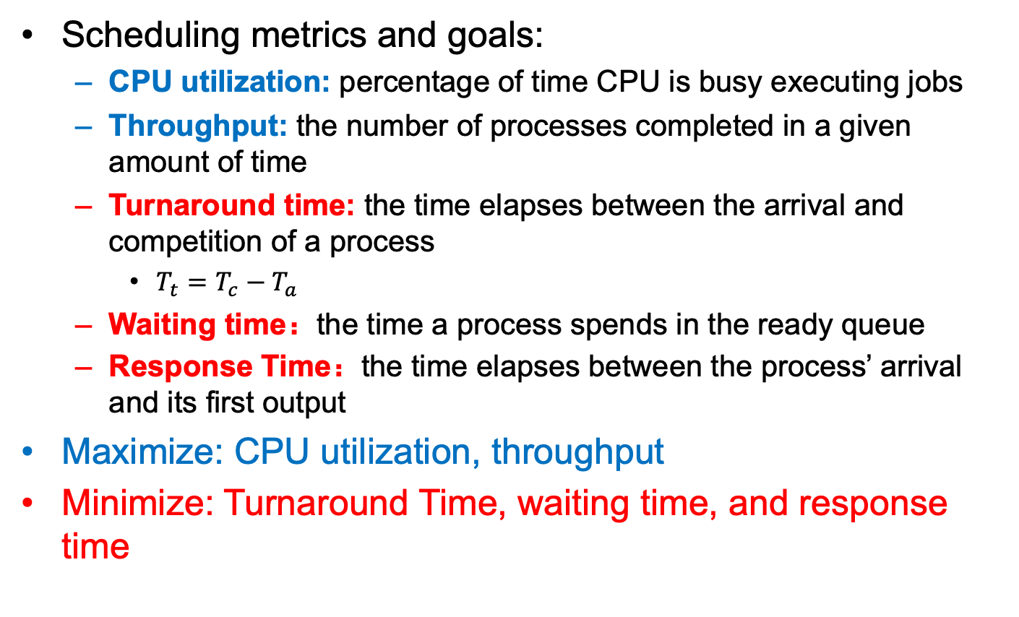
Terminologies
Scheduling metrics and goals:
CPU utilization: percentage of time CPU is busy executing jobs
Throughput: the number of processes completed in a given amount of time
Turnaround time: the time elapses between the arrival and competition of a process
$T_{t}=T_{c}−T_{a}$
Waiting time：the time a process spends in the ready queue
Response Time：the time elapses between the process’ arrival and its first output
Maximize: CPU utilization, throughput
Minimize: Turnaround Time, waiting time, and response time

Slide 5
Assumptions For Workloads
We adopt the following assumptions for the following slides:
Each job runs for the same amount of time
All jobs arrive at the same time
All jobs only use the CPU (no I/O)
Run-time of each job is known
Once started, each job runs to completion (Non-preemption)

Slide 6
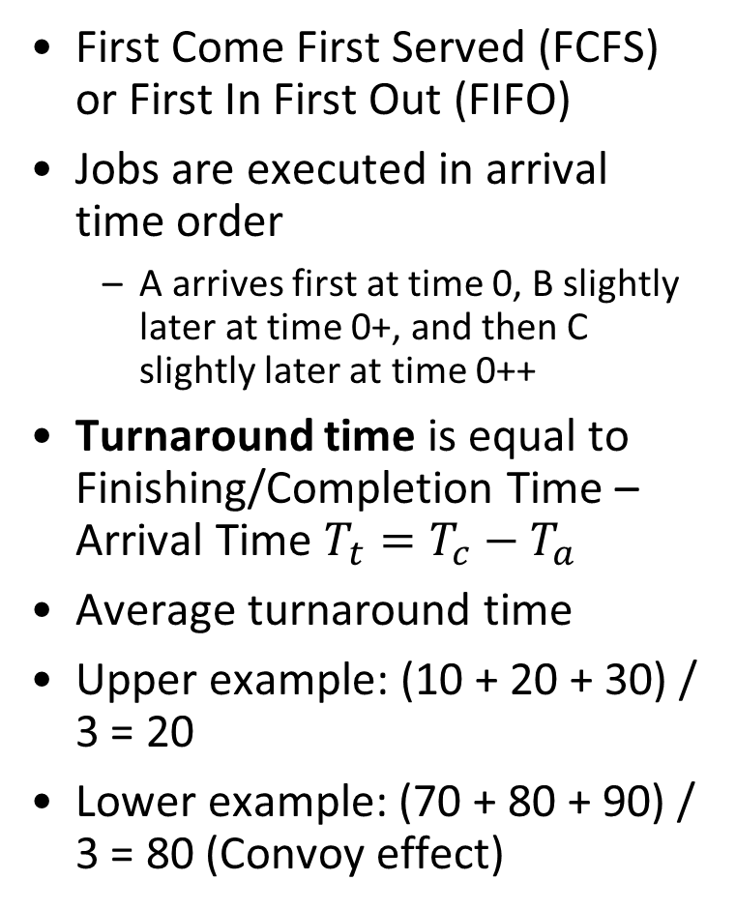
First In First Out (FIFO)
First Come First Served (FCFS) or First In First Out (FIFO)
Jobs are executed in arrival time order
A arrives first at time 0, B slightly later at time 0+, and then C slightly later at time 0++
Turnaround time is equal to Finishing/Completion Time – Arrival Time $T_{t}=T_{c}−T_{a}$
Average turnaround time
Upper example: (10 + 20 + 30) / 3 = 20
Lower example: (70 + 80 + 90) / 3 = 80 (Convoy effect)
Job | Arrival time (s) | Run time (s) | Finishing Time (s)
A | 0 | 10 | 10
B | 0⁺ | 10 | 20
C | 0⁺⁺ | 10 | 30
Average Turnaround Time |  |  | 20
A
B
C
Gantt Chart
0
10
20
30
Time
Job | Arrival time (s) | Run time (s) | Finishing Time (s)
A | 0 | 70 | 70
B | 0⁺ | 10 | 80
C | 0⁺⁺ | 10 | 90
Average Turnaround Time |  |  | 80
A
B
C
0
70
80
90
Time
Notes:
A: 10-0 = 10
B: 20-0 = 20
C: 30-0 = 30
Each job runs for the same amount of time
All jobs arrive at the same time
All jobs only use the CPU (no I/O)
Run-time of each job is known
Once started, each job runs to completion (Preemption)

Slide 7




First In First Out (FIFO)
Convoy effect
A large number of short jobs queued behind a long job, causing suboptimal overall performance.
Long job
Short job
Short job

Slide 8
Shortest Job First (SJF)
SJF policy: the job with the shortest execution time is scheduled first
Job | Arrival time (s) | Run time (s) | Finishing Time (s)
A | 0 | 70 | 90
B | 0 | 10 | 10
C | 0 | 10 | 20
 | Average Turnaround Time | Average Turnaround | 40
B
C
A
0
10
20
90
Time

Slide 9
Optimality of SJF
SJF is the optimal scheduling algorithm for minimizing the average turnaround time under the following assumptions:
All Jobs Arrive at the Same Time.
This ensures that the scheduler can make a complete decision about the order of execution based on job lengths without interruptions from newly arriving tasks.
Job Execution Times Are Known in Advance
The algorithm requires precise knowledge of each job’s run-time (execution time) to determine which job is the shortest. This assumption is often unrealistic in practice, as predicting exact execution times is challenging.
Non-Preemptive Scheduling
Once a job starts, it runs to completion without being interrupted by other jobs. This avoids complications like context switching but can lead to issues like starvation for longer jobs if shorter ones keep arriving.
Job | Arrival time (s) | Run time (s) | Finishing Time (s)
A | 0 | 70 | 70
B | 10 | 10 | 80
C | 20 | 10 | 90
 | Average Turnaround | Average Turnaround | (70+70+70)/3 = 70
A
B
C
0
70
80
90
Time
SJF is not optimal when task arrival times are different. Long job A arrives at time 0, it runs first. Short jobs B and C arrive later, but they cannot run immediately due to Non-Preemptive Scheduling
Notes:
Under these conditions, SJF minimizes the average turnaround time by prioritizing shorter jobs first, which reduces the waiting time for subsequent jobs and improves overall efficiency[1][2]. However, in more dynamic or realistic scenarios where jobs arrive at different times or execution times are not perfectly known, these assumptions may not hold, and the algorithm's optimality diminishes.Citations:[1] https://pages.cs.wisc.edu/~remzi/OSTEP/cpu-sched.pdf[2] https://intro2operatingsystems.wordpress.com/tag/sjfsrtf-scheduling/[3] https://www.reddit.com/r/AskComputerScience/comments/1ie0xb/cpu_scheduling_shortest_job_first/[4] https://www.youtube.com/watch?v=TC6CcmwRph8
(or CPU burst time)

Slide 10
Shortest Time-to-Complete First (STCF)
Shortest Time-to-Complete First (STCF) policy: is a preemptive scheduling algorithm that selects the job with the smallest remaining execution time to run next.
FIFO and SJF are both non-preemptive scheduling algorithms.
STCF is the optimal scheduling algorithm for minimizing the average turnaround time under the following assumptions:
Job Execution Times Are Known in Advance
Preemptive Scheduling
if a new job arrives with a shorter remaining time than the currently running job, the scheduler can preempt the current job and switch to the new one. This ensures that shorter jobs are prioritized even after longer jobs have started execution.
STCF does not optimize other metrics, such as response time or fairness.
Job | Arrival time (s) | Run time (s) | Finishing Time (s)
A | 0 | 70 | 90
B | 10 | 10 | 20
C | 20 | 10 | 30
 | Average Turnaround | Average Turnaround | (90+10+10)/3 ≈ 37
A
B
C
A
0
30
90
Time
10
20
Notes:
: The algorithm assumes that the exact CPU burst times (or execution durations) of all jobs are known. This is crucial because STCF selects the job with the shortest remaining time to completion.
It is an extension of SJF, but it allows for preemption, meaning the currently running process can be interrupted if a new job with a shorter remaining time arrives.

Slide 11
Response Time
Response time is another important performance metric, especially for interactive applications
FIFO
R = (0 + 30 + 50) / 3 = 26.7
SJF
R = (0 + 10 + 30) / 3 = 13.3
A better scheduler for response time?
Job | Arrival time (s) | Run time (s) | Finishing Time (s) | Response Time (s)
A | 0 | 30 | 10
B | 0⁺ | 30 | 20
C | 0⁺⁺ | 10 | 30
Average Turnaround Time |  |  | 20
Job | Arrival time (s) | Run time (s)
A | 0 | 30
B | 0⁺ | 20
C | 0⁺⁺ | 10

Slide 12
Round-Robin (RR)
A new concept of time quantum/time slice/scheduling quantum: a fixed and small amount of time units
Each process executes for a time slice
Switches to another one regardless whether it has completed its execution or not
If the job has not yet completed its execution, the incomplete job is added to the tail of the ready queue, FIFO queue.
Notes:
Alternate ready processes every fixed-length time-slice, you have a circular queue

Slide 13
Round-Robin (RR)
Job | Arrival time (s) | Run time (s) | Finishing Time (s) | Response Time (s)
A | 0 | 30 | 60 | 0
B | 0⁺ | 20 | 50 | 5
C | 0⁺⁺ | 10 | 30 | 10
Average Response Time |  |  |  | 5
Assume that time slice is 5s
A
B
C
A
B
C
A
B
A
B
A
A
0
60
Time
R = (0 + 5 + 10) / 3 = 5
Notes:
Alternate ready processes every fixed-length time-slice, you have a circular queue

Slide 14
Round-Robin (RR)
Job | Arrival time (s) | Run time (s) | Time quantum
A | 0 | 5 | 1
B | 0 | 5
C | 0 | 5
RR
R = (0 + 1 + 2) / 3 = 1
RR is a good scheduler in terms of response time
But poor in terms of turnaround time
FIFO: T = (5 + 10 + 15) / 3 = 10
SJF: T = (5 + 10 + 15) / 3 = 10
RR: T = (13 + 14 + 15) / 3 = 14

Slide 15
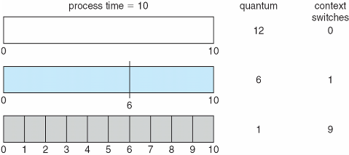
Round-Robin (RR)
If there are n processes in the ready queue and the time quantum is q, no process waits more than (n-1)q time units
The selection of time quantum size should be carefully considered (Usually 10-100 milliseconds)
Switching between processes comes at some overhead, i.e., context-switch time
Turnaround time depends on the size of time quantum
Notes:
Use a timer to implement this

Slide 16
Round-Robin (RR)
RR is also a starvation-free scheduler
Some processes never get scheduled, e.g., processes with long execution time in STCF
RR is fair, simple, and easy to implement and thus is used in modern OSs, such as Linux and MacOS.
XV6 implements a simple RR.
Notes:
when they shut down the IBM 7094 at MIT in 1973, they found a low-priority process that had been submitted in 1967 and had not yet been run.

Slide 17
Summary
There are different metrics to evaluate the performance of scheduling algorithms.
FIFO is a simple scheduler, but suffers from the convoy effect
SJF is an optimal scheduling algorithm in terms of minimizing average waiting time, if all jobs start simultaneously and know their execution times in prior
STCF is an optimal scheduling algorithm in terms of minimizing average turnaround time, if all jobs know their execution times in prior
RR is a better algorithm in terms of minimizing average response time

Slide 18
Incorporating I/O
All jobs only use the CPU (no I/O)
Every program uses I/O
Process execution consists of
CPU execution (CPU burst)
I/O wait (I/O burst)
CPU
A
A
A
B
I/O
A
A
Notes:
CPU burst
I/O burst
process execution consists of a cycle of CPU execution and I/O wait

Slide 19
Incorporating I/O
Treating each CPU burst as a sub-job
Schedule a CPU burst
Initialize the subsequent I/O burst, when the CPU burst completes
Switch to another process
A
A
A
B
CPU
A
B
A
B
A
B
CPU
Overlap
A
A
I/O
A
A
I/O
Run-time of each job is known

Slide 20
Priority-Based Scheduling
Run-time of each job is known
A priority level (integer) is assigned to each process
FIFO, SJF, STCF are special priority-based scheduling algorithms
The process with the highest priority is always scheduled
Priority-Based Scheduling:
Preemptive
Non-preemptive
Different priority assignment methods
Internal or external
The smaller number, the higher priority (usually)
Priority-based scheduling may suffer from starvation (solution: aging)
Notes:
Internal: timing constraints, memory requirements, the ratio of average I/O burst to average CPU burst
External: Importance of the process, financial considerations, hierarchy among users

Slide 21
Multi-Level Feedback Queue (MLFQ)
SJF and STCF are good for turnaround time, but poor for response time
In contrast, RR are good for response time, but terrible for turnaround time
We need a scheduling algorithms
Optimize turnaround time for batch programs
Minimize response time for interactive programs
Multi-level Feedback Queue (MLFQ) combines
Priority-based scheduling
RR

Slide 22
Multi-Level Feedback Queue (MLFQ)
MLFQ maintains a number of queues (multi-level queue)
each queue has a different priority level
Jobs which are on the same queue have same priority
Jobs are assigned to a queue
High priority
A
B
Rule 1: If priority(A) > Priority(B), A runs
A&B are scheduled before C
Rule 2: If priority(A) == Priority(B), A & B run in RR
C
Low priority

Slide 23
Multi-Level Feedback Queue (MLFQ)
MLFQ varies the priority of a job instead of having a fixed priority
MLFQ varies the priority of a job based on its observed behavior
Rule 3: When a job enters the system, it is placed at the highest priority
Rule 4a: If a job uses up an entire time slice while running, its priority is reduced (i.e., it moves down on queue).
Rule 4b: If a job gives up the CPU before the time slice is up, it stays at the same priority level

Slide 24
Multi-Level Feedback Queue (MLFQ)
Rule 3 and 4a (starts at the highest, and lower if not finished)
A long running job; Time slice is 10ms
High priority
Q2
Lower priority
Q1
Low priority
Q0
0
50
100
150
200
Time (ms)

Slide 25
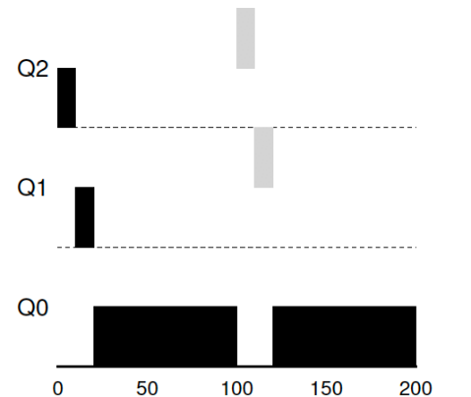
Multi-Level Feedback Queue (MLFQ)
Job A: A long-running CPU-intensive job
Job B: A short-running interactive job (20ms runtime), arrives at 100ms
A
B
High priority
Lower priority
Preemption
Low priority
Time (ms)

Slide 26
Multi-Level Feedback Queue (MLFQ)
Rule 4b (stays at the same priority);
Job A: A long-running CPU-intensive job
Job B: An interactive job that only needs CPU for 5ms before I/O
B
Remain at the same priority
A
Q2
High priority
Lower priority
Q1
Q0
Low priority
Time (ms)
Notes:
Take I/O into account

Slide 27
Multi-Level Feedback Queue (MLFQ)
What are the problems of the current MLFQ?
Starvation
Game the scheduler
Some sneaky tricks to get more resource share
Changed Behavior over time
A
B
Remain at the same priority
High priority
Q2
Q1
Lower priority
Low priority
Q0

Slide 28
Multi-Level Feedback Queue (MLFQ)
Starvation
B
Interactive jobs always occupy the CPU
C
A
Q2
High priority
Lower priority
Q1
Long-running job starves
Q0
Low priority

Slide 29
Multi-Level Feedback Queue (MLFQ)
Rule 5: After some time period S, move all the jobs in the system to the topmost queue.
B
Lower priority
C
A
Q2
High priority
Helpful for changed behavior
Q1
Q0
Low priority
Priority boost

Slide 30
Multi-Level Feedback Queue (MLFQ)
Rule 4a: If a job uses up an entire time slice while running, its priority is reduced (i.e., it moves down on queue).
Rule 4b: If a job gives up the CPU before the time slice is up, it stays at the same priority level
Rule 4: Once a job uses up its time allotment at a given level (regardless of how many times it has given up the CPU), its priority is reduced(i.e., it moves down one queue).

Slide 31
Multi-Level Feedback Queue (MLFQ)
B
A
Q2
High priority
Used up its time allotment
Lower priority
Q1
Q0
Low priority

Slide 32
Multi-Level Feedback Queue (MLFQ)
The refined set of MLFQ rules:
Rule 1: If Priority(A) > Priority(B), A runs (B doesn’t).
Rule 2: If Priority(A) = Priority(B), A & B run in RR.
Rule 3: When a job enters the system, it is placed at the highest priority.
Rule 4: Once a job uses up its time allotment at a given level (regardless of how many times it has given up the CPU), its priority is reduced(i.e., it moves down on queue).
Rule 5: After some time period S, move all the jobs in the system to the topmost queue.
Beauty of MLFQ
It does not require prior knowledge on the CPU usage of a process.

Slide 33
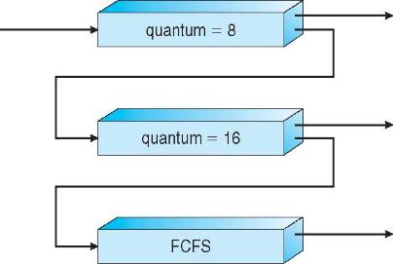
Multi-Level Feedback Queue (MLFQ)
MLFQ scheduler is defined by the following parameters
Number of queues
Time quantum of each queue
How often should priority be boosted?
Scheduling algorithms for each queue
etc.
High priority queue:
Interactive processes
Response time
Low priority queue:
Batch processes (CPU-intensive)
Turnaround time

Slide 34
Proportional Share Scheduling
Fair-share scheduler
Guarantee that each job obtain a certain percentage of CPU time.
Not optimized for turnaround or response time
Lottery scheduling
Based on the concept of tickets
The percentage of tickets denotes the share of a resource for a process
There are two processes, A and B.
Process A has 75 tickets → receive 75% of the CPU
Process B has 25 tickets → receive 25% of the CPU

Slide 35
Proportional Share Scheduling
A probabilistic way to implement lottery scheduling
Time slice (like in RR)
Scheduler knows how many tickets exist
Scheduler picks a winning tickets from the ticket pool for each time slice
Example
There are 100 tickets
Process A has 75 tickets: 0 ~ 74
Process B has 25 tickets: 75 ~ 99
Scheduler’s winning tickets:
63 85 70 39 76 17 29 41 36 39 10 99 68 83 63
Resulting scheduler:
A
B
A
A
B
A
A
A
A
A
A
B
A
B
A
A ≈ 74%
B ≈ 26%
Notes:
The longer these two jobs compete,
The more likely they are to achieve the desired percentages.

Slide 36
Completely Fair Scheduling (CFS)
Completely Fair Scheduling (CFS)
Choose the process with lowest execution time: vruntime.
Run the process for a time slice.
The current CPU scheduler in Linux (since 2.6.23, 2007)
Non-fixed time slice.
CFS assigns process`s time slice a proportion of the processor.
Priority
Enables control over priority by using nice value.
Efficient data structure.
Use red-black tree for efficient search, insertion and deletion of a process.
Notes:
Current linux kernel 6.1.1
17,900 lines of code

Slide 37
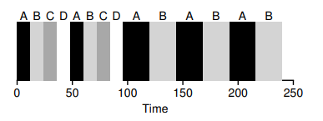
Completely Fair Scheduling (CFS)
Virtual runtime (vruntime)
Denotes how long the process has been executing.
Per-process variable
Increases in proportion with physical (real) time when it runs.
CFS will pick the process with the lowest vruntime to run next.
sched_latency
Used to determine how long a process should run before considering a switch.
A typical value is 48 (milliseconds)
process`s time slice = sched_latency / (the number of process)
N = 4, time slice = 12msec
N = 2, time slice = 24 msec
What if N = infinite, set the
minimum time slice value to 6 ms.

Slide 38
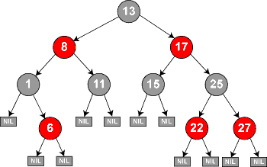
Completely Fair Scheduling (CFS)
CFS deploys a red-black tree
Balanced binary search tree
Ordered by vruntime as key
Complexity:
insertion, deletion, update -> O(logN)
find min -> O(1)

Slide 39
Completely Fair Scheduling (CFS)
How does CFS deal with I/O and sleep
When a process issues an I/O, it turns into sleep state. Then it will not accumulate vruntime
As soon as the long-sleep process is waked up, it has a small vruntime, i.e., a high priority. As a result, it is likely to monopolize CPU for a long while.
Solution: Set the vruntime of a wake-up process to the minimum value found in the RB-tree
How CFS boosts interactivity:
I/O-bound (Interactive) processes typically have shorter CPU bursts and thus will have a low vruntime – higher priority

Slide 40
Summary
Notes:
Scheduler is an important topic in OS
CFS 17,900 lines of code

